Slide 1
Tutorial
National Webinar
Hosting a Stakeholder Event to Advance your Mission

Slide 2
Today’s Webinar Leadership
Sharon Bonney, Executive Director, COABE
Kaye Sharbono, President, COABE
Diane Jackson, Adult Education Instructor and Ambassador Coordinator
Queen Creek School District Adult Education Program
Notes:
Sharon

Slide 3
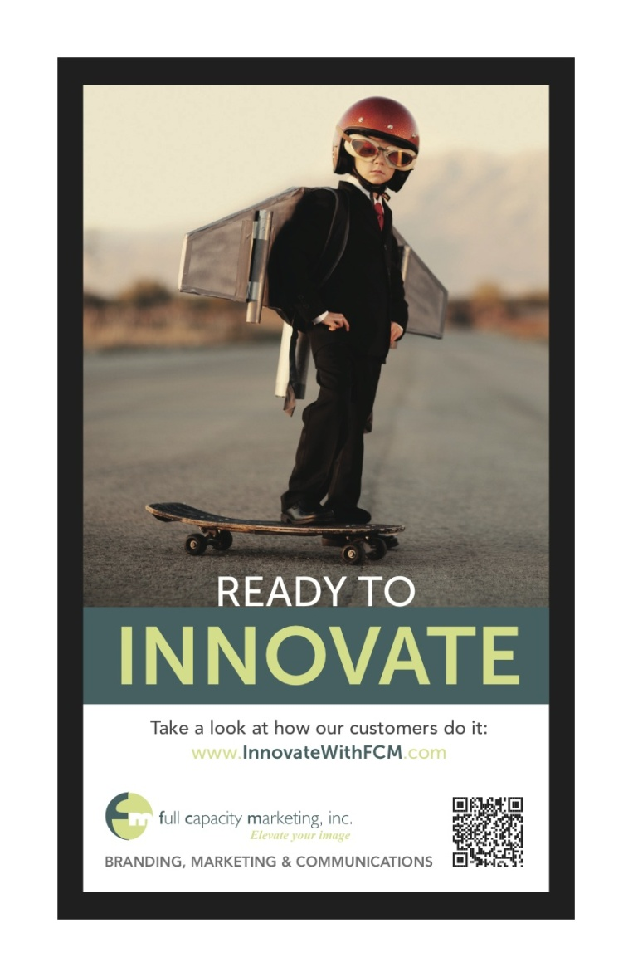
Meet our Communications Partner
Celina Shands, M.S. - CEO/Founder
Maryanne Conlin, MBA - Sr. Brand Director
Ivan Freaner, B.S. - Creative Director

Slide 4
Housekeeping
Chat Real Time: Chat with peers and presenters
Ask Questions: Type your questions in the Q & A box
Raise Your Hand: Let us know you are present

Slide 5
Event Planning Webinar Topics
Event Approaches & Timing
Potential Event Elements
Engaging Legislators
Promotional & Media Strategies
Using Cause Marketing
Case Studies
Planning Checklist

Slide 6
Event Approaches & Timing
An onsite event at your school is an opportunity to showcase your adult education programs to the community, key stakeholders & elected officials.
Potential Timing: Consider Leveraging….
Summer Recess (August 5th – Labor Day)
National Adult Education & Family Literacy Week (September 24 – 30, 2017)
Capitol Hill Visit (Last week September)

Slide 7
Potential Event Elements
Think “Visual”
Elected Official Presents Proclamation to the Host
Students Share Success Stories
Employer Endorsements & Highlight Partnerships
“Visual” Class Demo (e.g. CTE)
Mini Classes
Tour of School
Information Stations

Slide 8
Proclamation Presentation
Campaign Toolkit offers 2 different proclamations based on the timing of your event
Acknowledge elected official presenting the proclamation
Talking points about the proclamation
Invite students to share in ceremony with legislator to enhance photo opportunities

Slide 9
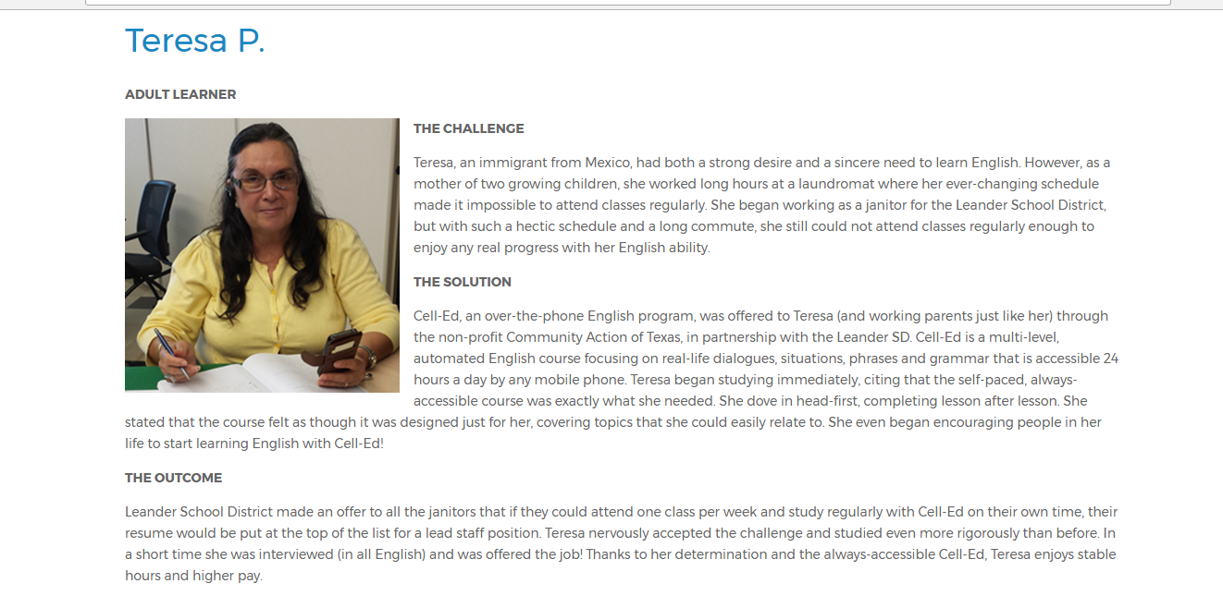
Student Speakers
Showcase Your Students
What was their challenge?
How did adult education change their situation?
Why would they recommend your school to others?
Create photo opportunities & meeting with legislators at the event
Students SHOW adult education success stories better than we can ever TELL them

Slide 10
Employer Speakers
Showcase Your Partners
Are there employers who have supported your adult school by partnering in work-based learning opportunities or hiring students?
Employers build credibility in your event line up by sharing their perspective about the importance of adult education.

Slide 11
Visual Demonstrations
Are there classes that can be demonstrated such as students learning a new skill set in CTE?
Can you host “mini classes” on various topics to give adult learners an actual experience of what you do in classes?
Is there something interesting that would provide a visual opportunity to showcase classes via a tour of the school or a particular class?
Could you set up Information Stations with passionate instructors that share information about their classes?

Slide 12
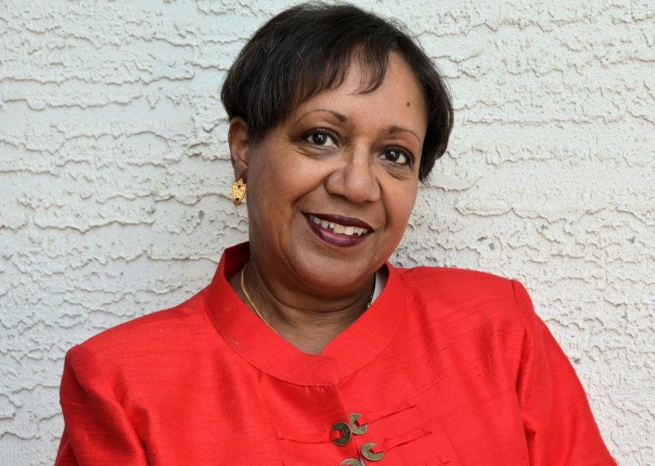
Guest Speaker: Events in Action
Diane Jackson Adult Education Instructor and Ambassador Coordinator
Queen Creek School District Adult Education Program
Queen Creek, Arizona

Slide 13
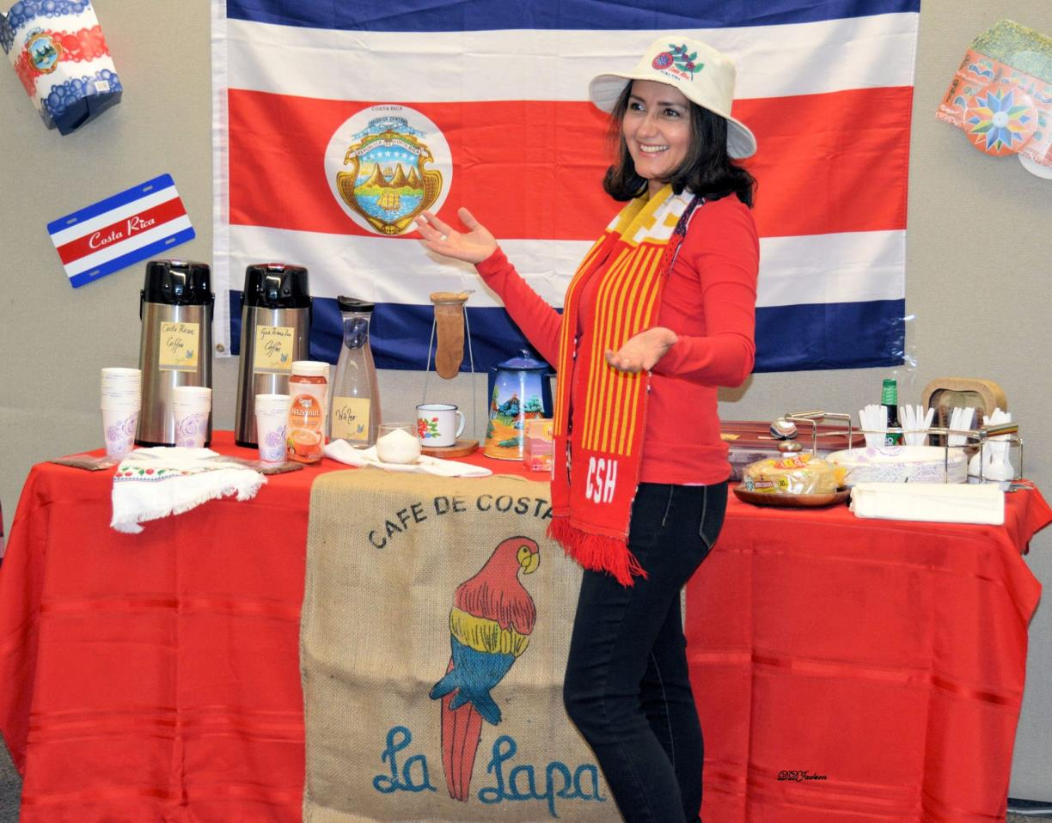
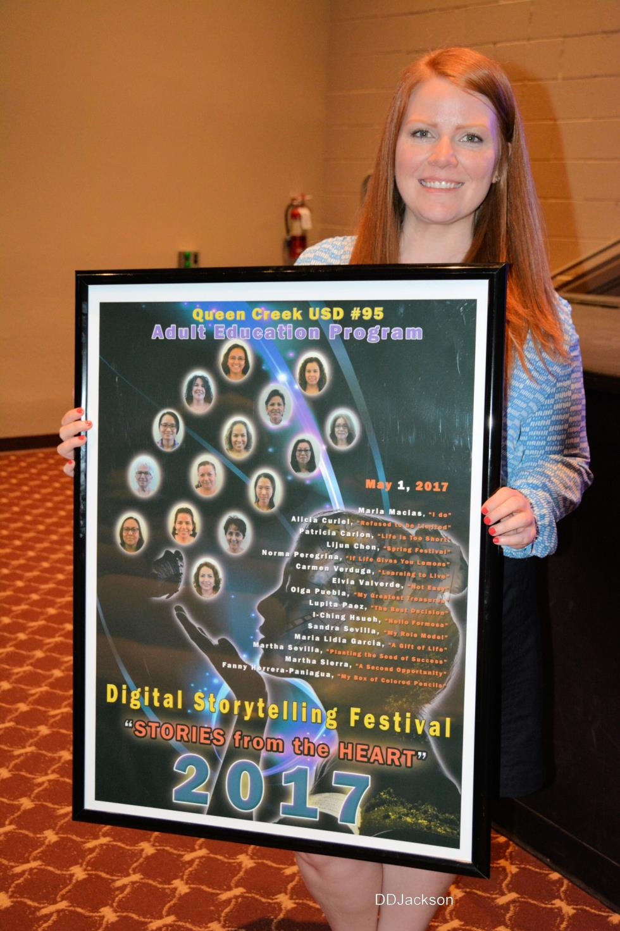
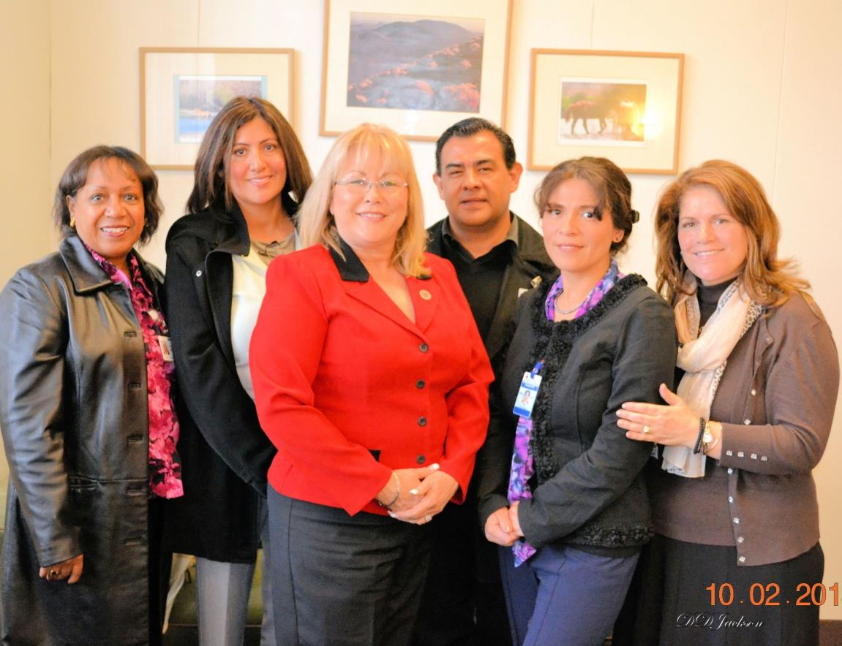
Stakeholder Event Examples
International Day
Film Festival Event

Slide 14
Stakeholder Analysis
Make sure you conduct a Stakeholder Analysis
We like to be certain we reach out to all of them—policy makers, community members (including families), elected officials, the business community, and the media
Relationships count

Slide 15
The VIP Treatment
Acknowledge VIPs for attending: Legislators, Funders & Executives
Legislators tell us they love visiting programs, especially when there are no expectations
If there’s going to be a crowd at your event, it’s an opportunity for legislators to mingle with their constituents and/or receive acknowledgement
It’s an opportunity to inform everyone about adult education

Slide 16
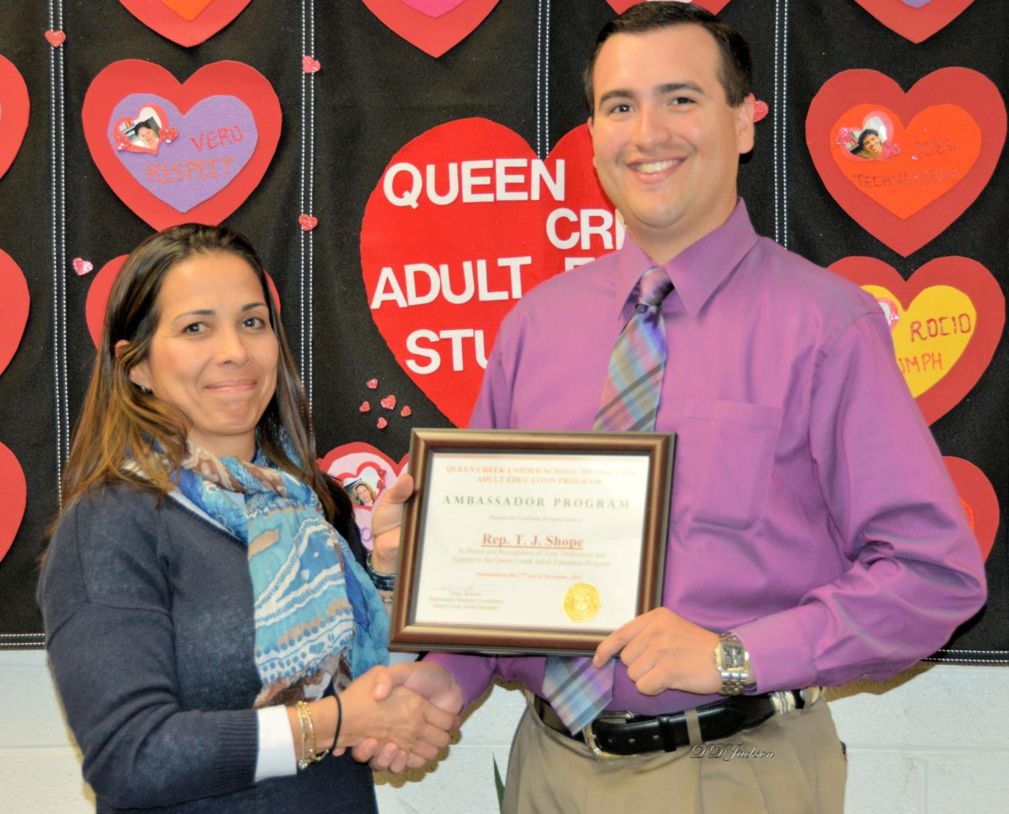
Let Your Students Shine
Let them lead tours
Showcase their work/accomplishments
Publically acknowledge their accomplishments
Students hold the power to influence stakeholders about the value of adult education

Slide 17
Promote, Promote, Promote
Send a media release to invite the news media
Send media releases to elected officials, even after the fact.
Someone in their offices will look at them.
The more hits, the better. (That’s why we’re on a first-name basis with secretaries and assistants!)
Use social media

Slide 18
Event Promotional Strategies
Sponsorships
News Media
Cause Marketing Strategies

Slide 19
Consider Sponsorships
Sponsorships can get you in touch with potential new employer partners.
It allows employers to have promotional opportunities to showcase their brand & demonstrate “good corporate citizenship”.
Providing a way for company employees to “get involved” increases likelihood of sponsorship.

Slide 20
News Media Engagement
Use the Media Advisory to invite the media to your event
Focus on the “Why” in the advisory
Make sure to include opportunities for photos & interviews with people involved in your event lineup
Send the Advisory prior to the event & the day of the event with phone call follow up
Include a Media Kit with photos, the Educate & Elevate Campaign Video, fact sheets about your program and a press release
Send a press release post event to media who did not attend

Slide 21
Cause Marketing Strategies
Cause marketing is when a for profit connects with a nonprofit or public sector organization for mutual benefit.

Slide 22
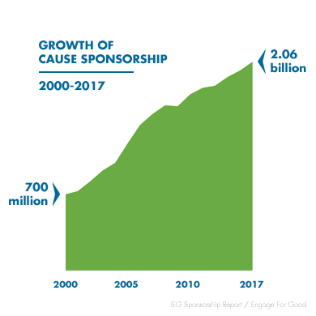
Growth of Cause Sponsorship
http://prosepad.com/blog/cause-marketing-statistics/#companies
Notes:
http://prosepad.com/blog/cause-marketing-statistics/#companies

Slide 23
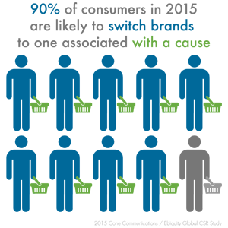
Cause Marketing Statistics
Businesses that support causes win big!
http://prosepad.com/blog/cause-marketing-statistics/#companies

Slide 24
Build a Business Case for Support
Adult Education is a CAUSE! Leverage that for a cause marketing partnerships…
Key Points for Your Meeting:
Why is adult education critical/urgent?
What issue does adult education solve for the community?
What is the solution?
Why should the potential partner be a champion the cause?
What are their benefits for partnership?

Slide 25
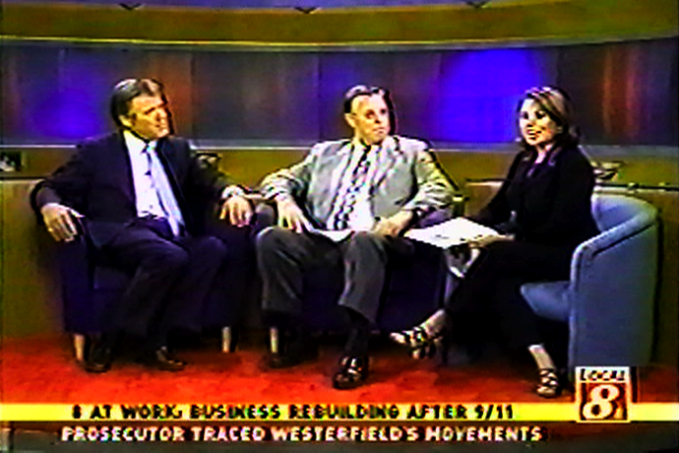
Case Study:
News Media Cause Marketing Partnership
http://fullcapacitymarketing.com/portfolio/kfmb-news-media-partnership-8-at-work-campaign/

Slide 26
Case Study:
News Media Cause Marketing Partnership
http://fullcapacitymarketing.com/portfolio/southern-californias-workforce-development-campaign/

Slide 27
Clear Channel Partnership
Flight Mentions, Streaming and On Air Spots
Additional PSAs
Web postings and dedicated section of site
Calendar Events inclusion
Newsletter eblast to 60,000+ registered users
Inclusion on the “HOT” Helping Others Together Community Page
Guerilla street marketing –Flyer distribution
Promotional Value: $43,100
Cost: $5,000

Slide 28
Cause Marketing Summary
Build a Business Case for Support (Campaign Fact Sheet)
Identify Potential Sponsorship Partners
Identify Potential Media Outlets for Partnerships
Connect with Media Outlet’s Sales & Marketing Divisions
Inventory Media Outlet’s Current Causes
Identify Potential Strategies for the Media as a Partner
Develop a Win-Win: They Get Exposure/Recognition; You Get Additional Promotional Opportunities

Slide 29
Event Planning Checklist
Check the Educate & Elevate Campaign Toolkit for a NEW Event Planning Checklist!

Slide 30
Your Calls to Action!
Review all Webinars
Submit Success Stories and Innovations via the Educate & Elevate Campaign Website (Submission Form)
Leverage your Human Interest Success Story + the Campaign Press Release Template to Announce your Participation in the Campaign
Send a Quick Fire Email to Support Adult Education
Share Quick Fire Links with Students, Colleagues & Friends

Slide 31
Build Capacity – Webinar Series
Social Media Strategies
Date: July 26, 2017 Time: 2:00 p.m. EDT
Adult Education State Director:
Mobilizing your State for Educate & Elevate
Date: August 18, 2017
Time: 2:00 p.m. EDT
Using Data for Storytelling:
State & Local Level
Coming Soon!

Slide 32
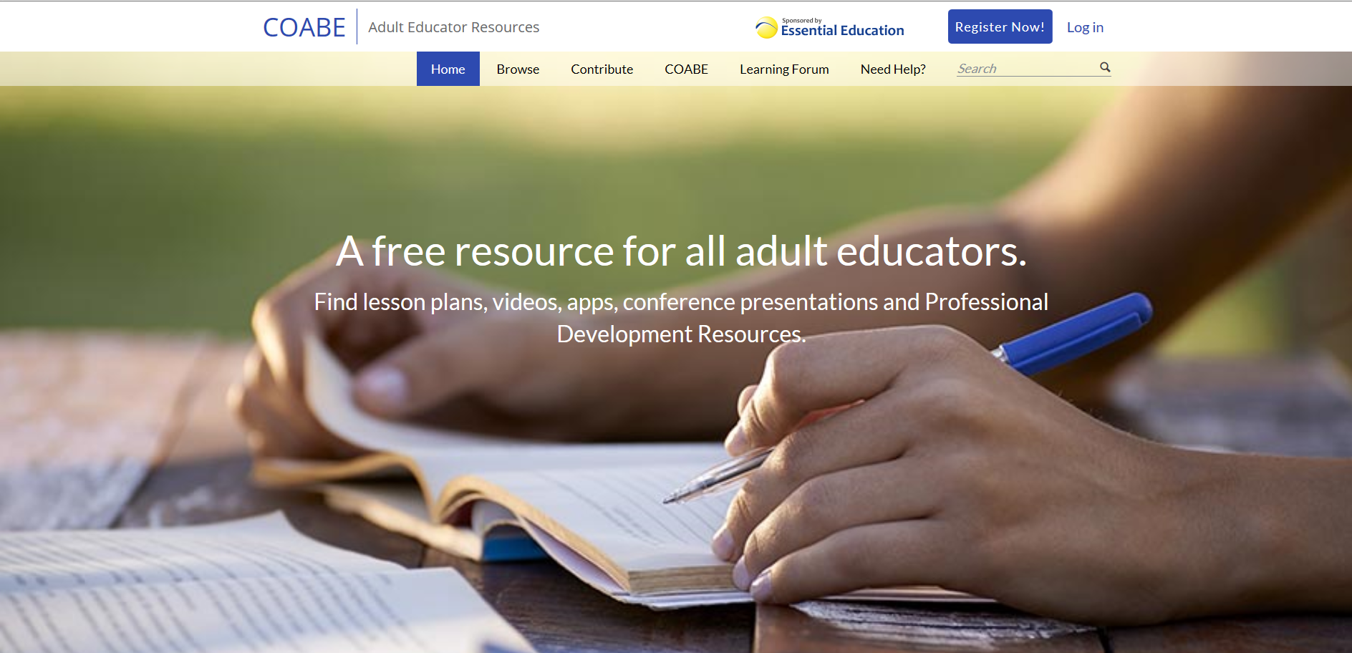
Learning Forum
Discussion Posts
Peer-to-Peer Learning
Apply the Toolkit & Share Successes
Get your Questions Answered
https://adultedresource.coabe.org/

Slide 33
Go to Learning Forum
https://adultedresource.coabe.org/

Slide 34
Take the Post Webinar Survey!
https://www.surveymonkey.com/r/NGB2HQV

