Slide 1
(Insert Name of State) Webinar
Our Participation in the Educate & Elevate Campaign

Slide 2
State Leadership
Insert the name of the state leadership who is facilitating the webinar or presentation

Slide 3
What is Educate & Elevate?
Some 55,000+ adult education leaders stand united in a national campaign to educate America about the importance of Adult Education in advancing career and college readiness for millions of people. We are urging policy makers to stay informed on our successes and to fund Adult Education at the $649 million level as called for in the Workforce Innovation and Opportunity Act enacted in 2014.

Slide 4
Topics
Why a National Campaign
Campaign Accomplishments to Date
(Insert Name of State) Strategies
Next Steps & Learning Forum TA

Slide 5
National Campaign: Why Now?
Budget Cuts
Lack of Understanding
Diminished Value

Slide 6
3 Campaign Goals
Create processes for a concerted, collective effort to reach local, state and federal officials & our communities.
Inform & educate officials about the relevancy of adult education through data, stories, innovations & key message points.
Make specific asks to support funding adult education.

Slide 7
Top Reasons to Participate & Mobilize
Increase investments in adult education (Hill Visits, Technology)
Demonstrate that adult education is a value added partner for WIOA-funded workforce organizations (Legislative Speaking Points)
Through advocacy, reposition adult education as an economic catalyst (Op-Eds)
Get your organization recognized locally, statewide & nationally (State Innovation Strand at Conference; Conference Award; Highlight in Educate & Advocate)
Deploy effective communications strategies about adult education (Toolkits)
Build capacity of adult education organizations to effectively communicate (Webinars)

Slide 8
Why Collective Storytelling?
https://www.youtube.com/watch?v=q1a7tiA1Qzo&feature=youtu.be

Slide 9
Campaign Elements: Web Tour
http://educateandelevate.org/

Slide 10
Our State Landing page
Insert Snapshot of your state-specific landing page.
Insert URL of your state-specific landing page here

Slide 11
Campaign Elements: Toolkit Tour
http://educateandelevate.org/campaign-tools/

Slide 12
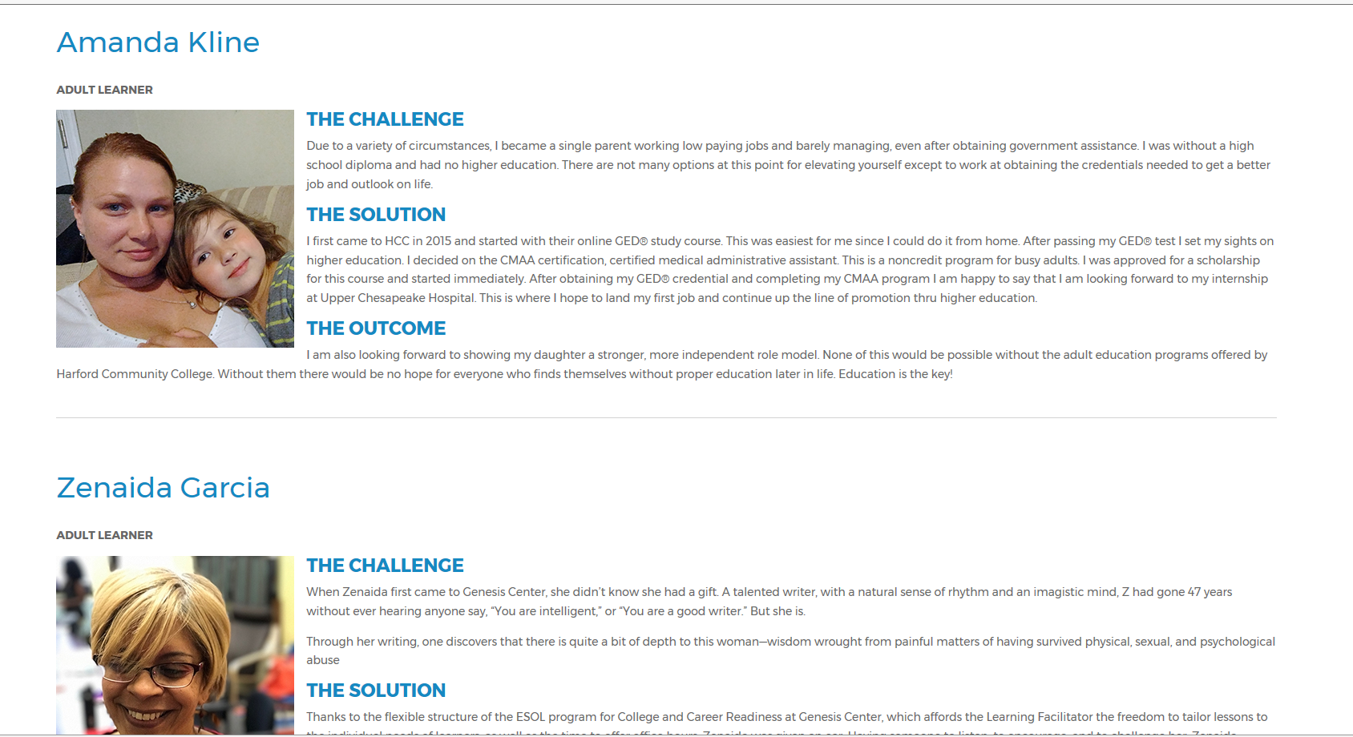
Submit Success Stories
Adult Learner Success Submissions: http://educateandelevate.org/adult-learner-success/
Employer Success Submissions: http://educateandelevate.org/employer-success/

Slide 13
Submit Innovations
Submit Innovations: http://educateandelevate.org/innovations/

Slide 14
Our State Strategies
Insert strategies here
Examples:
Our Press Release Announcement
New Subpage on our Website
Social Media Posts
Submission of Stories & Innovations

Slide 15
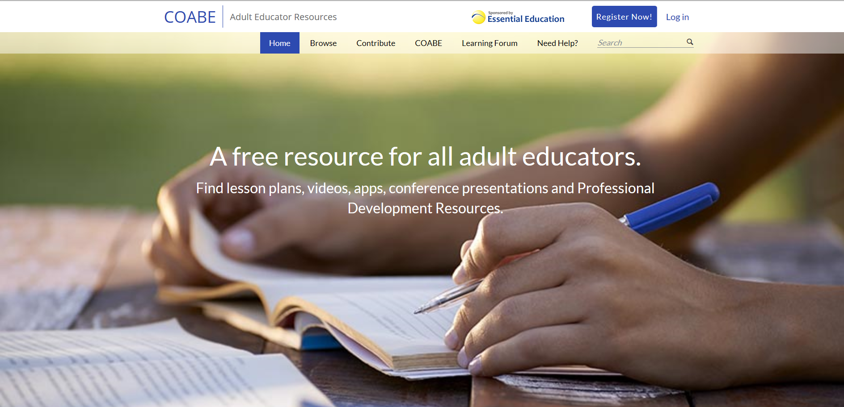
Tap into the Learning Forum
Discussion Posts
Peer-to-Peer Learning
Apply the Toolkit & Share Successes
Get your Questions Answered
https://adultedresource.coabe.org/

Slide 16
Go to Learning Forum
https://adultedresource.coabe.org/

